Slide 1
Chapter 10
Systems analysis

Slide 2
Learning objectives
After this lecture, you will be able to:
  define the importance of conducting the analysis phase to the overall success of the system;
  choose appropriate techniques for analysing users’ requirements for an information system;
  construct appropriate textual descriptions and diagrams to assist in summarising the requirements as an input to the design phase.

Slide 3
Management issues
From a managerial perspective, this lecture addresses the following areas:
  Which different aspects of the system must be summarised in the requirements document?
  Which diagramming tools are appropriate to summarise the operation of the existing and proposed systems?

Slide 4
Systems analysis
Systems analysis [1] is about finding out what the new system is to do, rather than how. There are two basic components to the analysis process:
Fact-finding – an exercise needs to take place where all prospective users of the new system should contribute to determining requirements.
Documentation – detailed systems design follows the analysis stage and it needs to be based on unambiguous documentation and diagrams from the analysis stage.
Systems analysis: The investigation of the business and user requirements of an information system. Fact-finding techniques are used to ascertain the user’s needs and these are summarised using a requirements specification and a range of diagramming methods.

Slide 5
Factors that will affect the type of analysis
The result of the ‘make-or-buy decision’: Made during the feasibility stage, a ‘make’ decision where bespoke software is developed will need a more detailed analysis than a ‘buy’ decision where packaged software is purchased off-the-shelf, especially when the results of the analysis process are fed into the design stage.
Application complexity: A very complex system or one where there are linkages to other systems will need very careful analysis to define system and subsystem boundaries, and this will lead to use of more formal techniques when compared with a simple or stand-alone application.
User versus corporate development: User development does not lend itself to extensive use of formal analysis tools. However, basic analysis is required and there are certain analysis tools that user developers can use that increase the probability of success. Similarly, where application development by IS/IT professionals occurs there will be a need for a more formal approach, especially where systems cut across functional boundaries.

Slide 6
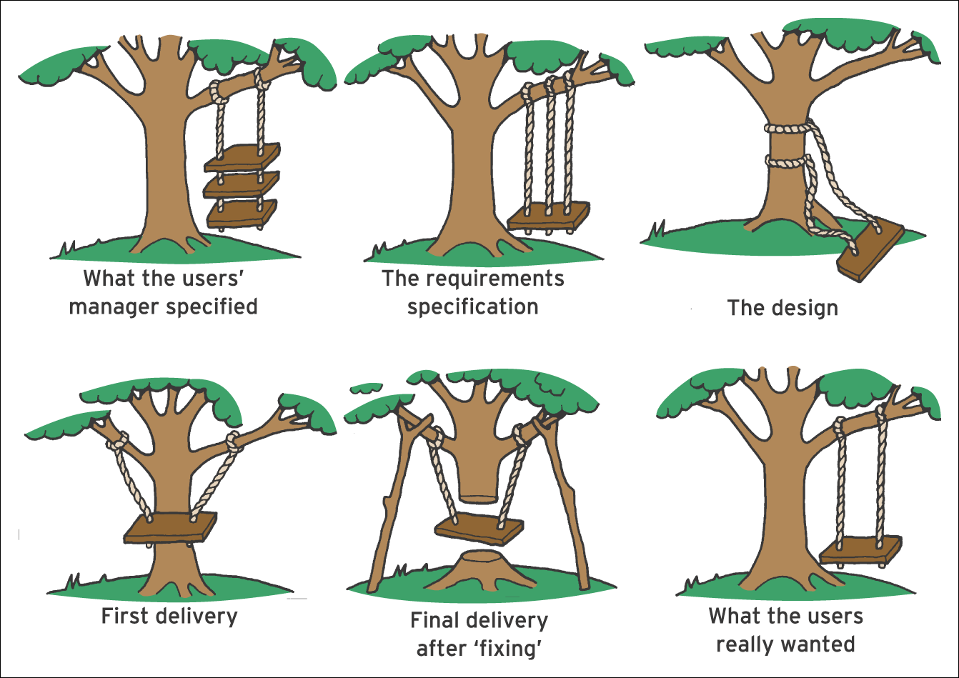
Figure 10.1 Varying interpretations of a user’s requirements at different stages
in a project

Slide 7
Analysis technique – interviewing
Recommended practice: A range of staff are interviewed using structured techniques to identify features and problems of the current system and required features of the future system.
Closed questions: Closed questions have a restricted choice of answers such as Yes/No or a range of opinions on a scale from ‘strongly agree’ to ‘strongly disagree’ (Lickert scale). Approach is useful for quantitative analysis of results.
Open questions: Asked to elicit opinions or ideas for the new system or identify commonly held views amongst staff. Open questions are not typically used for quantitative analysis, but can be used to identify a common problem.

Slide 8
Interviewing benefits
The ability to gather detailed information through a two-way dialogue
The ability for candid, honest responses to be made
An open, spontaneous process which can lead to valuable insights, especially when open questions are used
Responses that can easily be quantified, especially when closed questions are used
Being one of the best methods for gathering qualitative data such as opinions, and subjective descriptions of activities and problems.

Slide 9
Interviewing disadvantages
The analyst’s findings may be coloured by his or her perceptions of how other, similar, business operations work. Interviewers need to be especially skilled if this is to be avoided.
The development of a new information system may represent a threat through the risk of deskilling, redundancy or perceived inability to cope with change. Interviewees may, therefore, not cooperate with the interview process, either by not taking part or by giving vague and incomplete replies.
The interviewee may tell the analyst what he or she thinks should happen rather than what actually happens.
An interview at lower organisational levels may not yield as much information as some other methods if staff in this area are not capable of articulating with sufficient clarity.

Slide 10
Analysis technique – questionnaires
Questionnaires are used to obtain a range of opinion on requirements by targeting a range of staff. They are open to misinterpretation unless carefully designed. They should consist of both open and closed questions.

Slide 11
Success factors – questionnaires
The questions will be framed by the analyst with a clear view of the information that is to be obtained from the completed questionnaires.
The target audience must be carefully considered – a questionnaire designed for clerical or operational personnel should not contain questions that are not relevant to their level of work.
The questionnaire should only contain branching (e.g. ‘if the answer to Question 3 was ‘No’, then go to Question 8’) if it is absolutely necessary – multiple branches create confusion and may lead to unusable responses.

Slide 12
Success factors – questionnaires (Continued)
Questions should be simple and unambiguous so that the respondent does not have to guess what the analyst means.
Multiple-choice, Lickert-scale-type questions make the questionnaire easier to fill in and allow the results to be analysed more efficiently.
The questionnaire should contain the required return date and name of the person to whom the questionnaire should be returned.

Slide 13
Questionnaires – problems
The inability of respondents to go back to the analyst to seek clarification about what a question means
Difficulty in collating qualitative information, especially if the questionnaire contains open-ended questions
The inability to use verbal and non-verbal signals from the respondent as a sign to ask other or different questions
Low response rates – these can be lower than 20 to 25 per cent when sent to other organisations or customers, which means that a large sample size is needed if the results are to carry any weight. Response rate is not such a problem with internal staff.

Slide 14
Analysis technique – documentation review
Uses information on existing systems such as user guides or requirements specifications together with paper or on-screen forms used to collect information such as sales order forms.

Slide 15
Documentation benefits
If carried out at the beginning of a requirements analysis exercise, it will help provide the analyst with some background information relating to the area under consideration.
It may also help the analyst construct a framework for the remainder of the exercise and enable interviews to be conducted in a more effective way since the analyst has some idea of current business practices and procedures.
If document review is carried out later, it can be used to cross-check the actual business operations with what is supposed to happen.

Slide 16
Documentation – problems
There can be a large quantity of data for an analyst to process. This is especially true in large organisations and it may take the analyst a long time to identify the documentation that is useful and that which can be ignored.
Documentation is often out of date. If there is an old computerised system, it is quite possible that the documentation has not been changed for years, even though the system may have changed considerably over that period. The same can be said for the documentation of activities and procedures.

Slide 17
Documentation – benefits
The ability to see how documents and records are actually handled and processed
Observation may give a greater insight into actual business operations than simple paper documentation
Identification of particular operations that take a long time
The opportunity to see how different processes interact with each other, thus giving the analyst a dynamic rather than a static view of the business situation under investigation.

Slide 18
Analysis technique – observation
Useful for identifying inefficiencies in an existing way of working either with a computer-based or manual information system. Involves timing how long particular operations take and observing the method used to perform them.

Slide 19
Analysis technique – brainstorming
Brainstorming uses interaction within a group of
staff to generate new ideas and discuss existing problems. It is the least structured of the fact-finding techniques.

Slide 20
Requirements specification
Requirements specification: The main output from the systems analysis stage. Its main focus is a description of what all the functions of the software will be.
Typically includes:
  Data capture
  Preferred data capture methods
  Functional requirements
  User interface layout
  Output requirements.

Slide 21
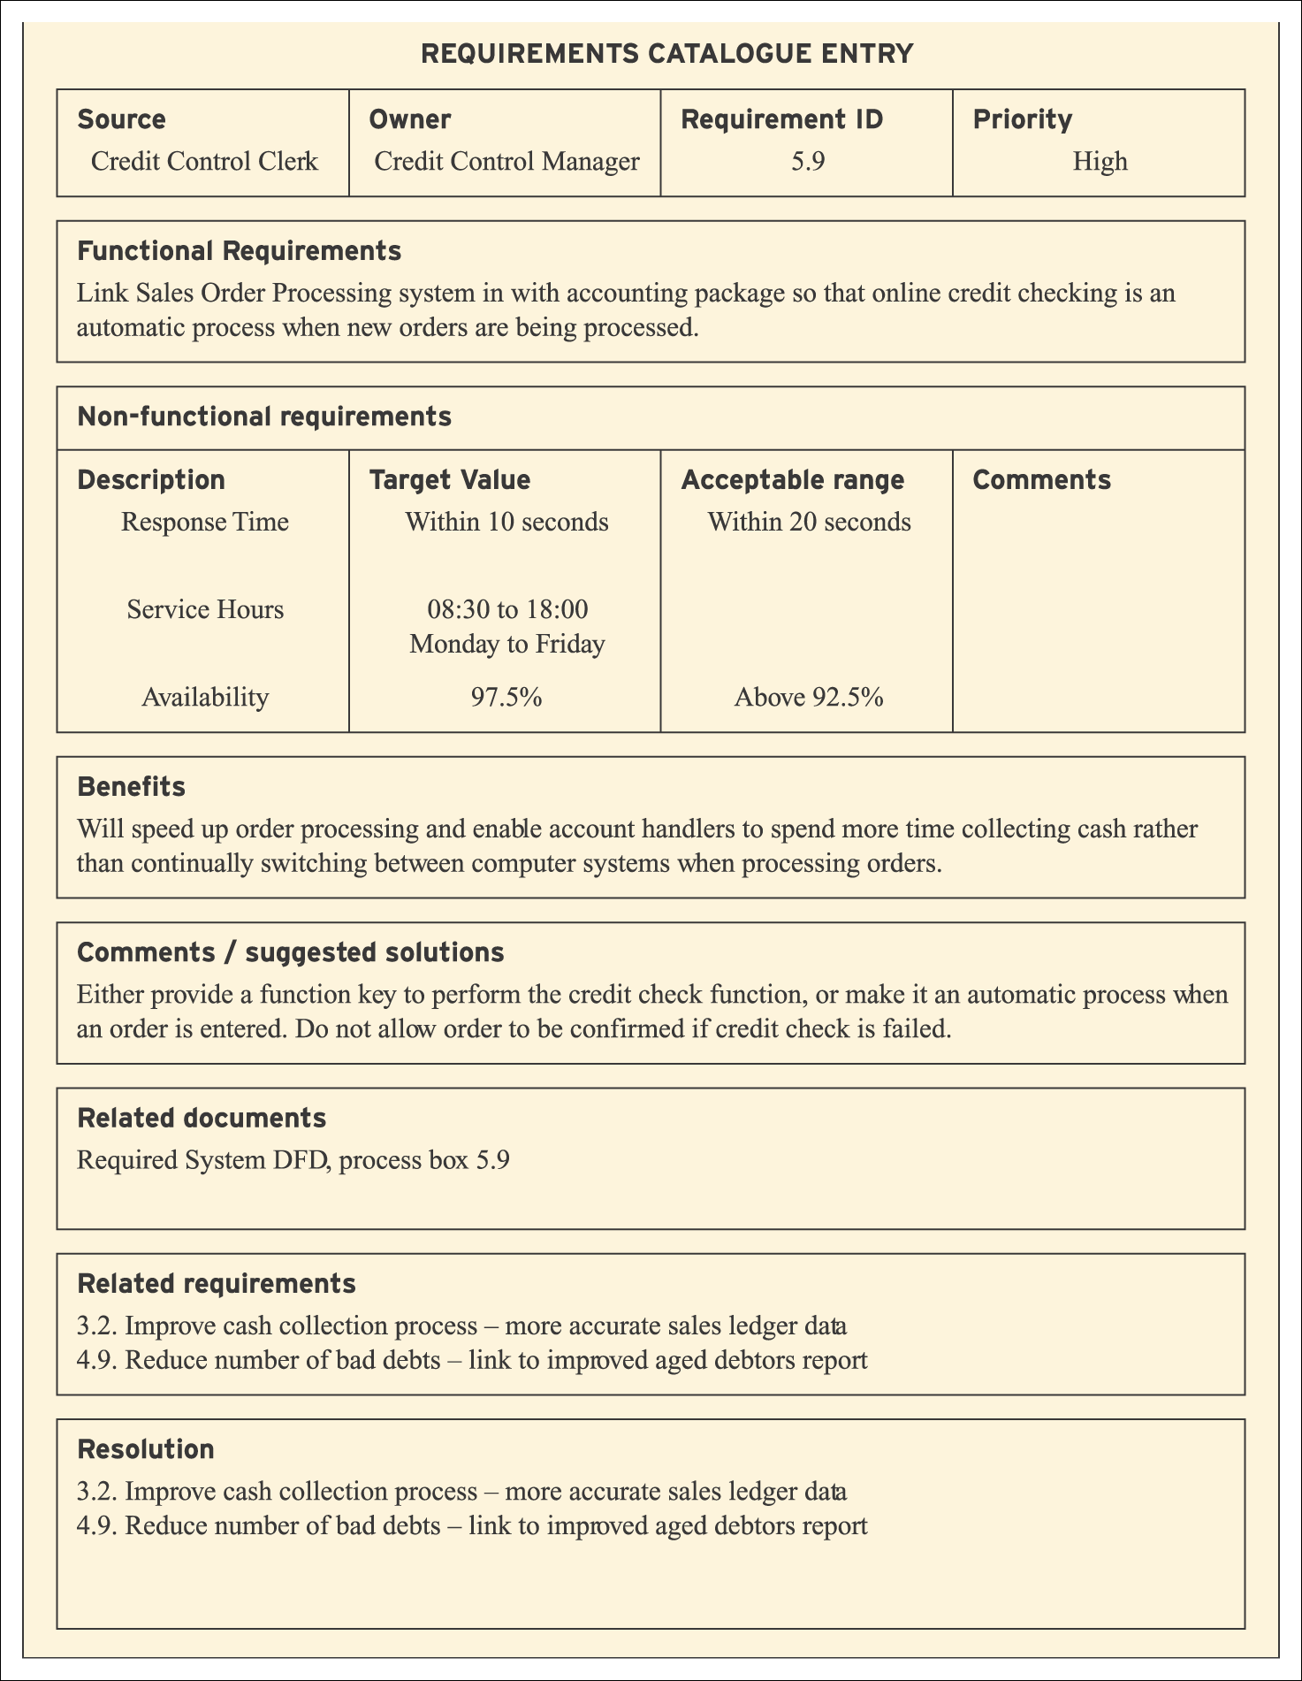
Figure 10.2 Example of a requirements catalogue entry

Slide 22
Different types of requirements
Functional requirements: Consist of requirements that perform the activities that run the business. Examples include updating master files, enquiring against data on file, producing reports and communicating with other systems.
Non-functional requirements: Define the performance levels of the business functions to be supported. Examples include online response times, turn-round time for batch processing, security, backup and recovery.
Quantification of requirements: Refers to the need for a measure of quality if the benefits are to be properly evaluated. Examples might include reducing customer complaints by 75%, reducing the value of unsold stock by 85% or increasing online sales by 25%.

Slide 23
Information flow diagram (IFD)
Information flow diagram (IFD): A simple diagram showing how information is routed between different parts of an organisation. It has an information focus rather than a process focus.
Purpose:
  to document the main flows of information around the organisation;
  for the analyst to check that they have understood those flows and that none has been omitted;
  for the analyst to use during the fact-finding process itself as an accurate and efficient way to document findings as they are identified;
  as a high-level (not detailed) tool to document information flows within the organisation as a whole or a lower-level tool to document an individual functional area of the business.

Slide 24
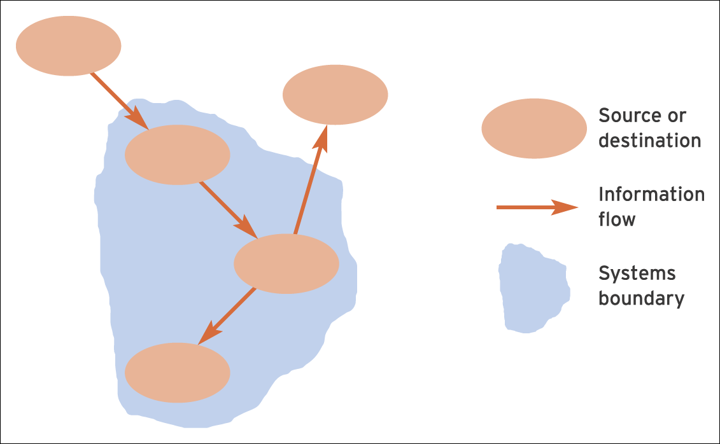
Figure 10.3 Information flow diagrams – the basic building blocks

Slide 25
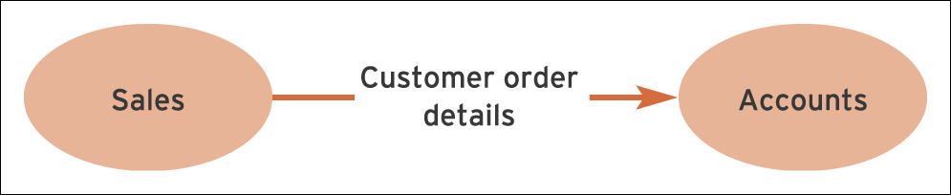
Figure 10.4 An illustration of a simple information flow

Slide 26
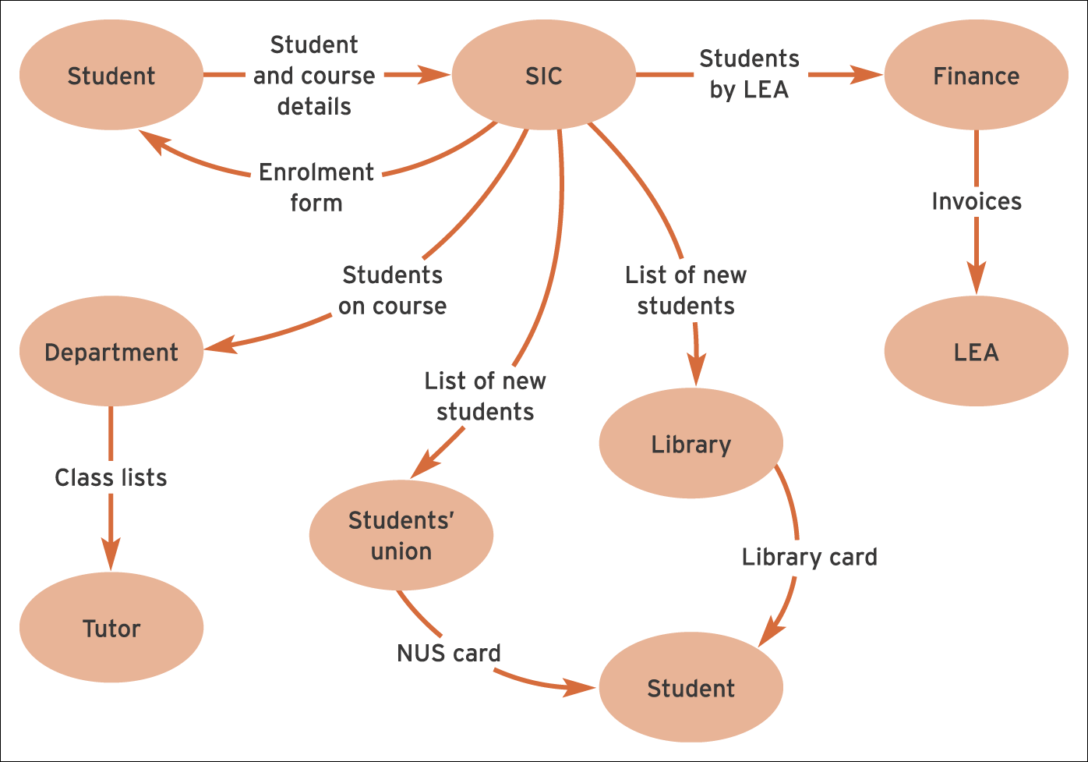
Figure 10.5 A simple, high-level IFD, excluding the system boundary

Slide 27
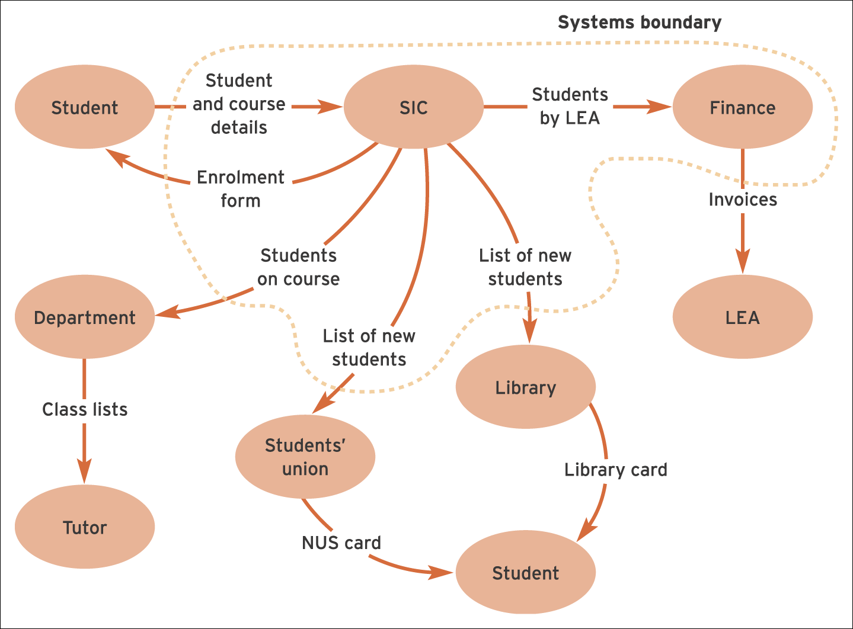
Figure 10.6 The completed IFD, including the system boundary

Slide 28
Context diagrams
Context diagrams: Simplified diagrams that are useful for specifying the boundaries and scope of the system. They can be readily produced after the information flow diagram since they are a simplified version of the IFD showing the external entities.

Slide 29
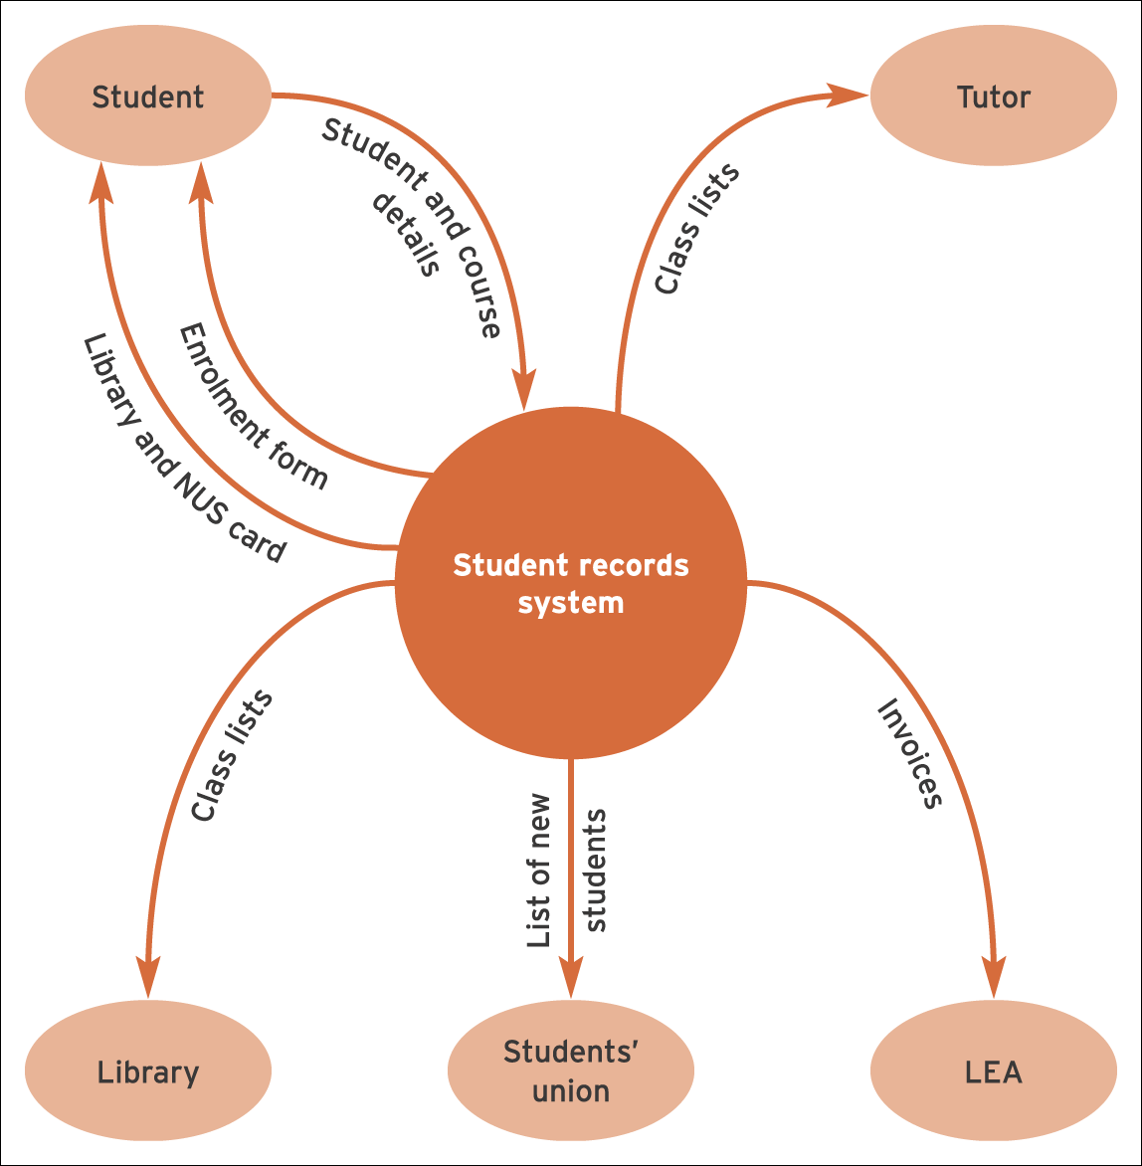
Figure 10.7 Context diagram for the student loan system described in Case Study 10.1

Slide 30
Dataflow diagrams (DFDs)
Dataflow diagrams (DFDs): Define the different processes in a system and the information that forms the input and output of the processes. They may be drawn at different levels. Level 0 provides an overview of the system with levels 1 and 2 providing progressively more details.

Slide 31
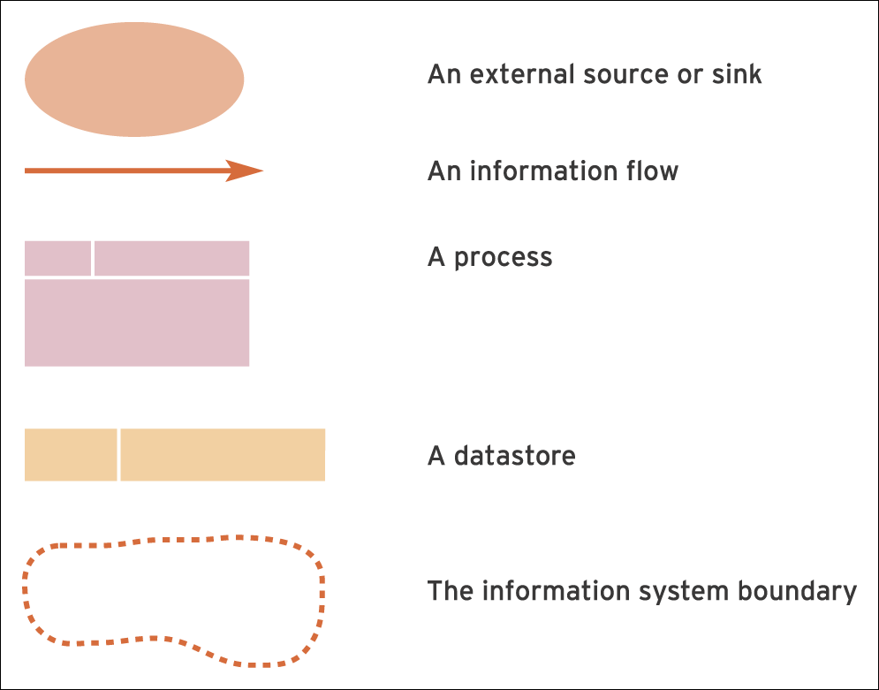
Figure 10.8 Symbols used in data flow diagrams

Slide 32
DFD elements
Datastores: A datastore can either provide data as input to a process or receive data that has been output from a process. The amount of time that data would spend in a datastore can vary from a very short time (e.g. fractions of seconds in the case of some work files) to much longer periods (e.g. months or years in the case of master files).
Dataflows: A dataflow describes the exchange of information and data between datastores and processes and between processes and sources or sinks. Note that in this context we are using data in a broad sense (to include information) rather than in the narrow sense used in Part 1 of the book.
Systems boundary: This remains the same as for an IFD –
it indicates the boundary between what lies inside the system under consideration and what lies outside.

Slide 33
DFD – best practice
Data do not flow directly between processes – the data that enter a process will come either from a source or from a datastore, they cannot exist in a vacuum!
Data do not flow directly between datastores – there must be an intervening process that takes the input data and converts them into a new form and outputs them to either a datastore or a sink.
Data do not flow directly from a datastore to a sink, or from a source to a datastore – there must be an intervening process.

Slide 34
DFD – five steps
Identify and list all processes which take place in the system under consideration. A process is an event where an input of some kind, from either a source or a datastore, is transformed into an output (the output being either to a sink or to a datastore).
Identify all the datastores which you think exist in the system under consideration. A datastore will exist wherever a set of facts needs to be stored about persons, places, things or events.
For each process identified in Step 1, identify where the information used in the process comes from (this can be from a source or a datastore or from both) and identify the output(s) from that process (which can be an information flow to a sink or to a datastore or to both).
Draw a ‘mini-DFD’ for each single process, showing the process box and any relevant sources, sinks or datastores.
Link the mini-DFDs to form a single diagram, using the datastores to link the processes together.

Slide 35
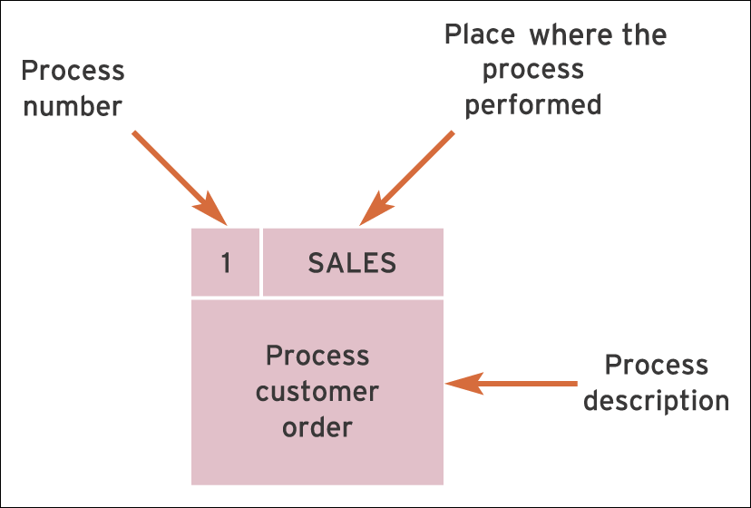
Figure 10.9 An example of a Level 1 process in a DFD

Slide 36
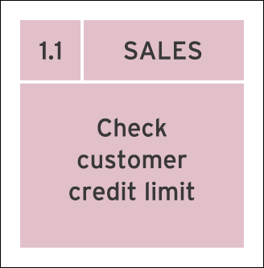
Figure 10.10 An example of a Level 2 process in a DFD

Slide 37
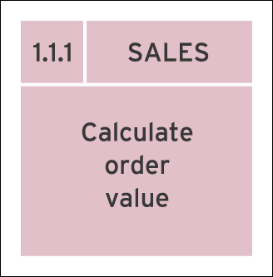
Figure 10.11 An example of a Level 3 process in a DFD

Slide 38
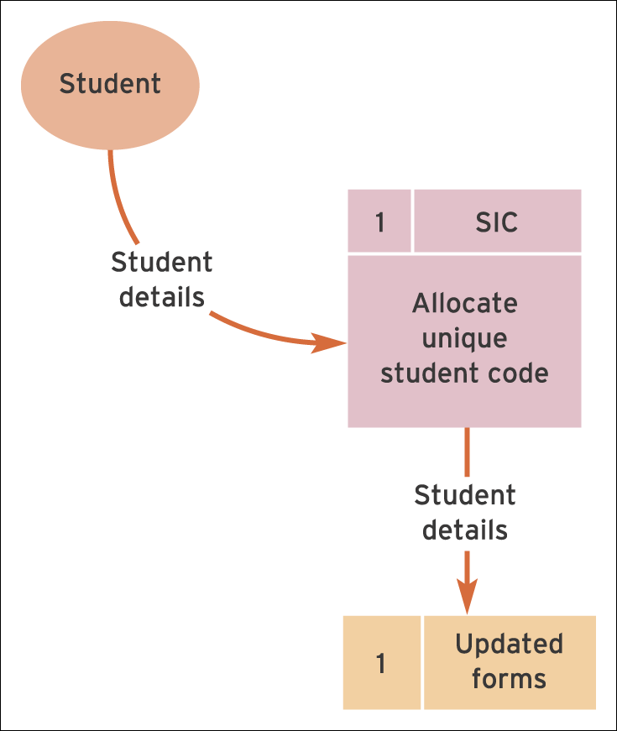
Figure 10.12 Mini-DFD for process 1

Slide 39
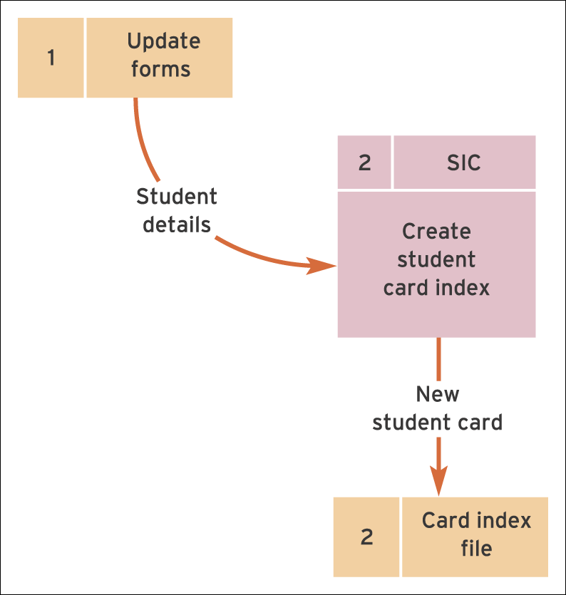
Figure 10.13 Mini-DFD for process 2

Slide 40
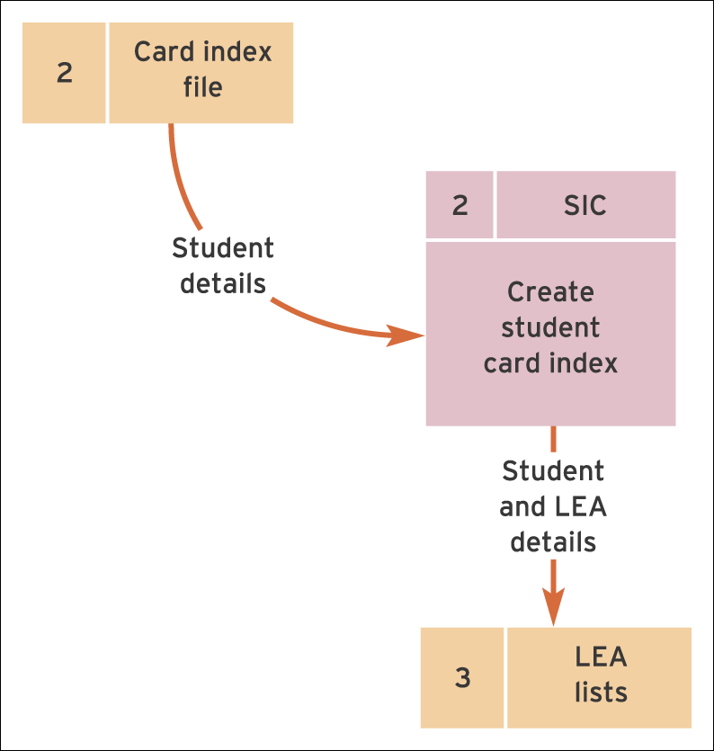
Figure 10.14 Mini-DFD for process 3

Slide 41
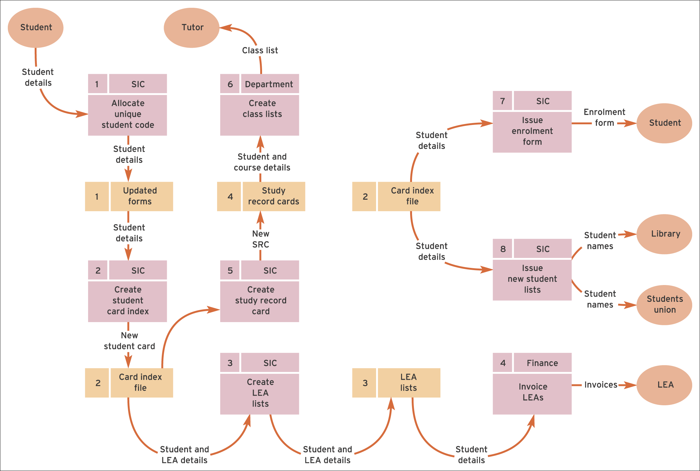
Figure 10.15 Completed DFD for the student record system

Slide 42
Entity relationship diagrams (ERDs)
Provide a data-focused view of the main data objects or entities within a system such as a person, place or object and the relationships between them. It is a high-level view and does not consider the detailed attributes or characteristics of an object such as a person’s name or address.
Entity: An object such as a person, place, thing or event about which we need to capture and store data. An entity forms a data about a particular object.

Slide 43
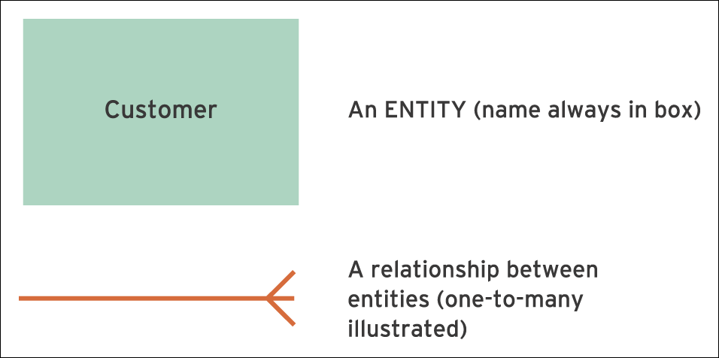
Figure 10.16 Essential symbols in an entity relationship diagram

Slide 44

Figure 10.17 A one-to-one relationship

Slide 45

Figure 10.18 A one-to-many relationship

Slide 46

Figure 10.19 A many-to-many relationship

Slide 47

Figure 10.20 A many-to-many relationship decomposed into two one-to-many relationships

Slide 48
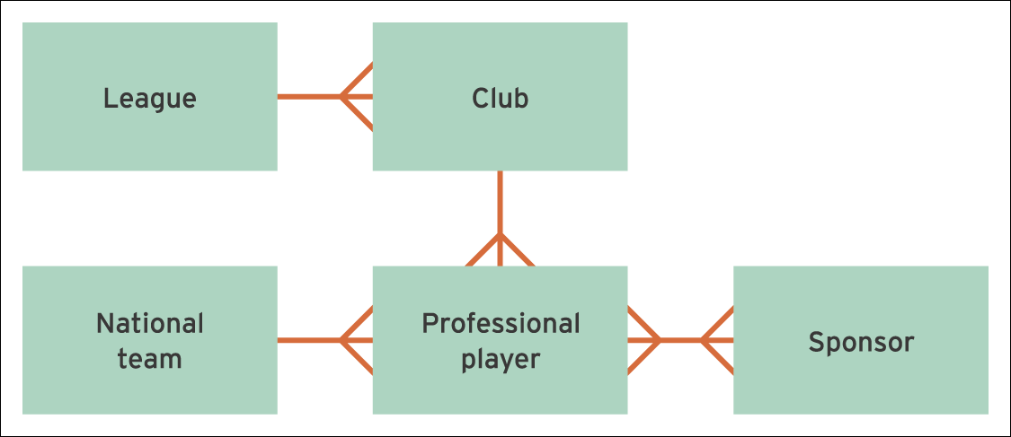
Figure 10.21 First ERD for the professional hockey example

Slide 49
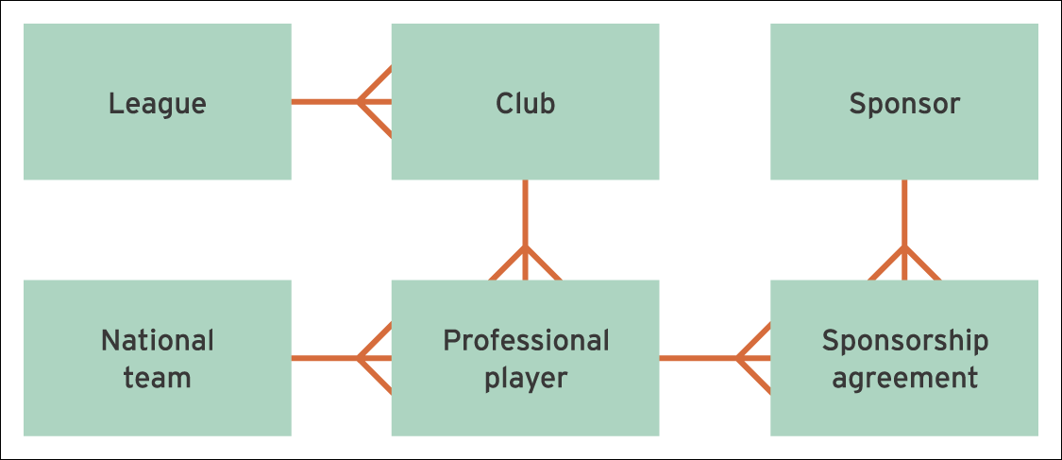
Figure 10.22 Final ERD for the professional hockey example

Slide 50
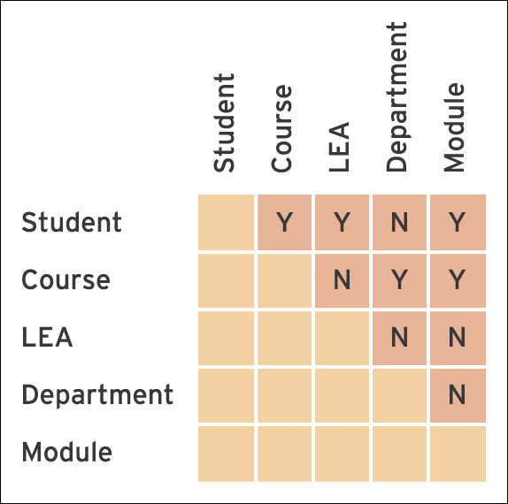
Figure 10.23 Cross-reference matrix for student records system

Slide 51
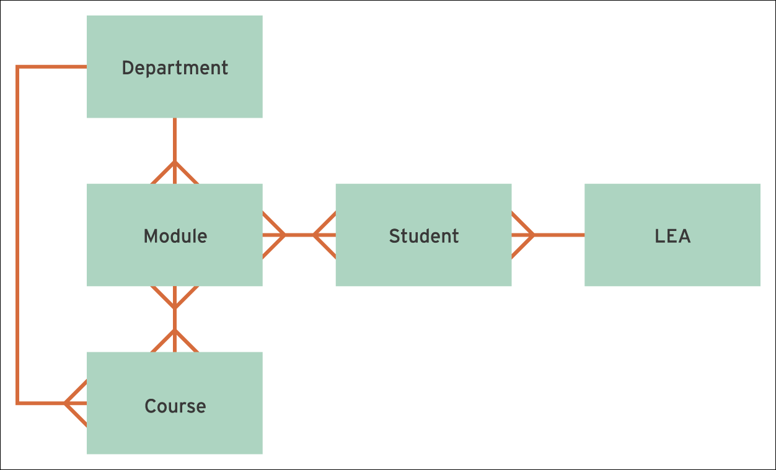
Figure 10.24 Student record system ERD – with many-to-many relationship

Slide 52
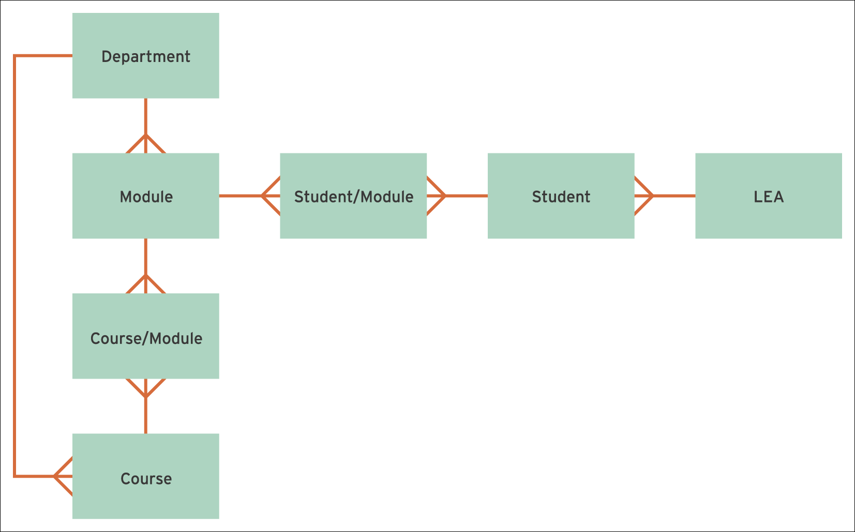
Figure 10.25 Final student record system ERD – with many-to-many relationships decomposed

Slide 53
Soft systems methodology (SSM)
Soft systems methodology: A methodology that emphasises the human involvement in systems and models their behaviour as part of systems analysis in a way that is understandable by non-technical experts.
Human activity system: A human activity system can be defined as ‘notional system (i.e. not existing in any tangible form) where human beings are undertaking some activities that achieve some purpose’.

Slide 54
SSM stages
Stage 1: The problem situation: unstructured
Stage 2 The problem situation: expressed
Stage 3: Root definitions of relevant systems
Stage 4: Building conceptual models
Stage 5: Comparing conceptual models with reality
Stage 6: Assessing feasible and desirable changes
Stage 7: Action to improve the problem situation

Slide 55
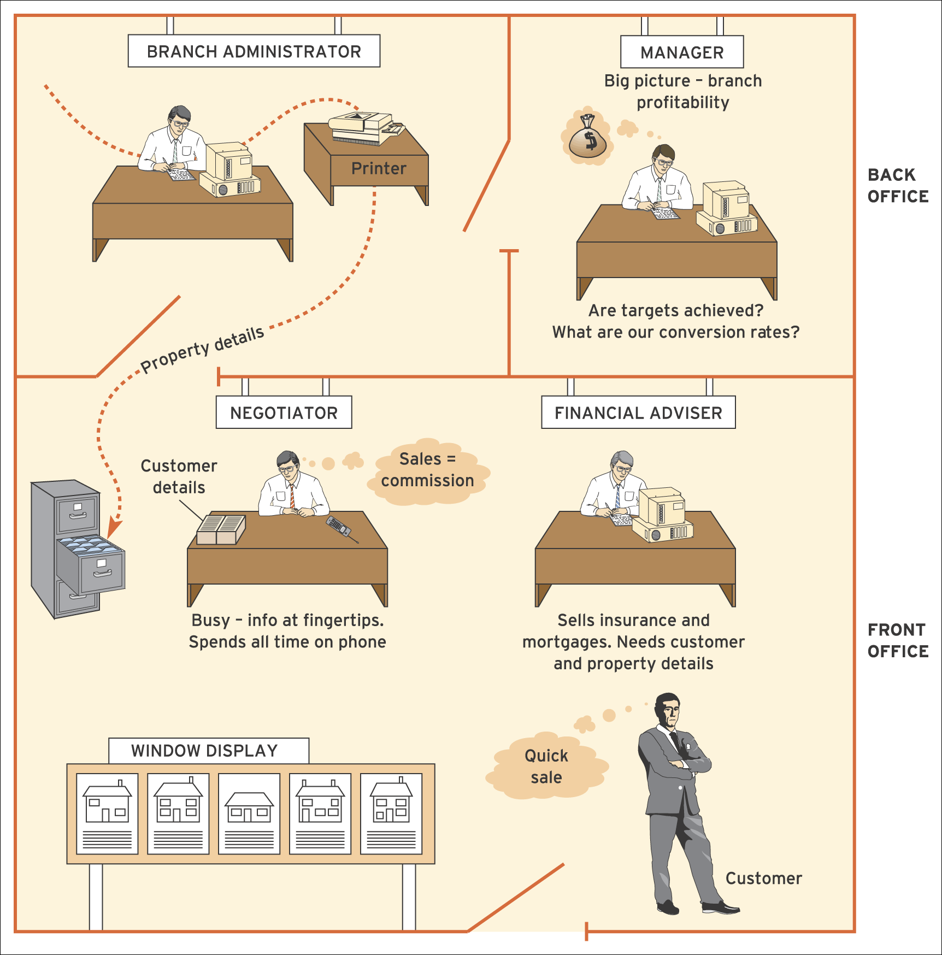
Figure 10.26 An example of a rich picture for an estate agency showing the needs and responsibilities of different staff

Slide 56
CATWOE
Clients or customers – the person(s) who benefit, or are affected by or suffer from the outputs of the system and its activities that are under consideration.
Actors – those who carry out the activities within the system.
Transformation – the changes that take place either within or because of the system (this lies at the heart of the root definition).
Weltanchauung or Worldview – this refers to how the system is viewed from an explicit viewpoint; sometimes this term is described as assumptions made about the system.
Owner – the person(s) to whom the system is answerable: the sponsor, controller or someone who could cause the system to cease.
Environment – that which surrounds and influences the operation of the system but which has no control over it.

Slide 57
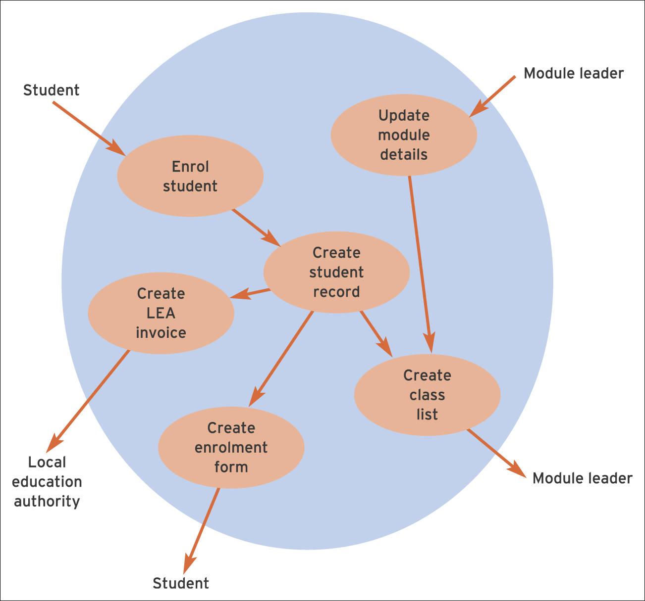
Figure 10.27 Conceptual models – a simple example

